Slide 1


TEAM PROMAX’s PITCH DECK
WATTWISE
SPLITS THAT FIT
WATTWISE: SOLAR
A FORECAST-LED LOCAL SOLAR ENERGY ALLOCATION ENGINE
SIME DARBY HACKATHON: TOWNSHIP OF TOMORROW
Notes:
Slide 1 of the corrected WattWise pitch deck.

Slide 2

TEAM PROMAX:
01 TEAM LEAD
SHERI ANNE CHONG TING TING · LEAD, FULL-STACK
UNIVERSITY OF SOUTHAMPTON MALAYSIA (UOSM)
satc1g24@soton.ac.uk
019-807 2503
02 MEMBERS
ONG HUI MIN · UI/UX DEVELOPER, RESEARCH
UOSM · hmo1e25@soton.ac.uk
JESS LAU XI EN · UI/UX DESIGNER, DEVELOPER
UOSM · xel1n24@soton.ac.uk
LIM POH SHIU · DATA ANALYST, QA
UOSM ·psl1e25@soton.ac.uk
Notes:
Slide 2 of the corrected WattWise pitch deck.

Slide 3

1) PROBLEM STATEMENT
CREAM makes SDP pre-allocate each buyer's share of solar four months ahead.
120
9
6%
days
sen/kWh
of solar given away
Each buyer's share is filed in writing before the month starts, before its real demand is known.
Access charge still paid by SDP to release solar a buyer didn’t use.
Median waste of 6% under a fixed yearly split. One buyer pair in ten wastes 16% or more.
CREAM Guidelines 9.9, 9.10(e), 13.2 (Energy Commission, 2025; Skrine, 2025). Replay on real meters, 407 buyer pairs (Miller et al., 2020; WattWise, 2026).
Check these numbers: Appendix A (solar given away), re-runnable in the testing suite.

Slide 4
2) TARGET USER(S)
Who has the problem today, and what WattWise changes
01
02
03
CREAM aggregators
Elmina homeowners
CREAM buyers
TODAY
TODAY
TODAY
SDP files every buyer's share 120 days ahead
Fixed splits waste solar, so SDP has limited room to add more roofs.
Innovation Park today; a school, petrol stations and commercial hubs have shown interest
WITH WATTWISE
WITH WATTWISE
WITH WATTWISE
Each split is sized to the buyer's predicted use.
Up to 20% more homes can lease their roofs at no extra waste (modelled).
Each share comes from the buyer's own meters.
Buyer interest: The Malaysian Reserve (2025). Waste figures: median of 407 real buyer pairs (WattWise, 2026).
Check these numbers: Appendix A (solar given away) and Appendix C (room for 20% more roofs).

Slide 5
3) OUR SOLUTION: WATTWISE
A software layer that replaces a fixed yearly guess with a monthly plan.
ESTIMATE
ALLOCATE
FILE
LEARN
Each buyer's use, from its own meter history
Share sized to the estimate; a slice held back for a fallback buyer, NEDA
(New Enhanced Dispatch Arrangement)
Stamped with its 120-day notice date
Each month checked against real use
THE RULE ANYONE CAN CHECK BY HAND
estimate = same month last year × (1 + trend)
No weather, no machine learning. Replay and rules: 02 Scheduler Module/replay.py (WattWise, 2026).

Slide 6
4) INNOVATION & DIFFERENTIATION
What gives WattWise a new approach?
Makes & stores solar
Manages one building
Signs up roofs
Plans CREAM shares
Solarvest · GSPARX · Plus Xnergy
✓
–
–
–
Schneider Electric · Tanand
–
✓
–
–
Bright Energy · GSPARX
–
–
✓
–
WATTWISE
✓
WattWise works with these players inside the CREAM ecosystem, not against them.
Company roles summarised from their public descriptions; not independently verified.

Slide 7
5) HOW IT WORKS
Theme: Planet · Smart energy efficiency
1
2
3
4
5
READ
ESTIMATE
ALLOCATE
FILE
LEARN
3 files in
120 days ahead
share + hold-back
notice-stamped
after TNB bills
meter readings · past splits · solar output
same month last year × trend
2% of solar held back for NEDA
SDP files with the Energy Commission
suggested vs filed vs actual
Result: solar given away drops from 6.05% to 1.34% (median, 407 buyer pairs).
Check these numbers: Appendix A (6.05% to 1.34% given away).

Slide 8
6) IMPACT
Less solar is thrown away
78%
less solar given away than a fixed split
99.8%
of 407 real buyer pairs: WattWise gives away less than a fixed split
RM108k–265k
Median share of the year's solar given away from 407 real buyer pairs
For the 1,368-roof Elmina example (2 assumed buyers): 443 MWh a year kept local, about 330 tonnes of CO₂e avoided, and room for about 20% more roofs (modelled).
CO₂e at 0.740 t/MWh, Peninsular Malaysia grid, 2024 provisional (Energy Commission, 2026).
a year more at 6,000 homes. Scales with solar generated, not buyers (modelled)
Real meters from 821 buildings (Miller et al., 2020) with rooftop solar at Elmina (European Commission JRC, 2022). Re-run it yourself in the testing suite.
Check these numbers: Appendix A (waste and CO₂e), B (income and how it scales), D (how many buyer pairs improve).

Slide 9
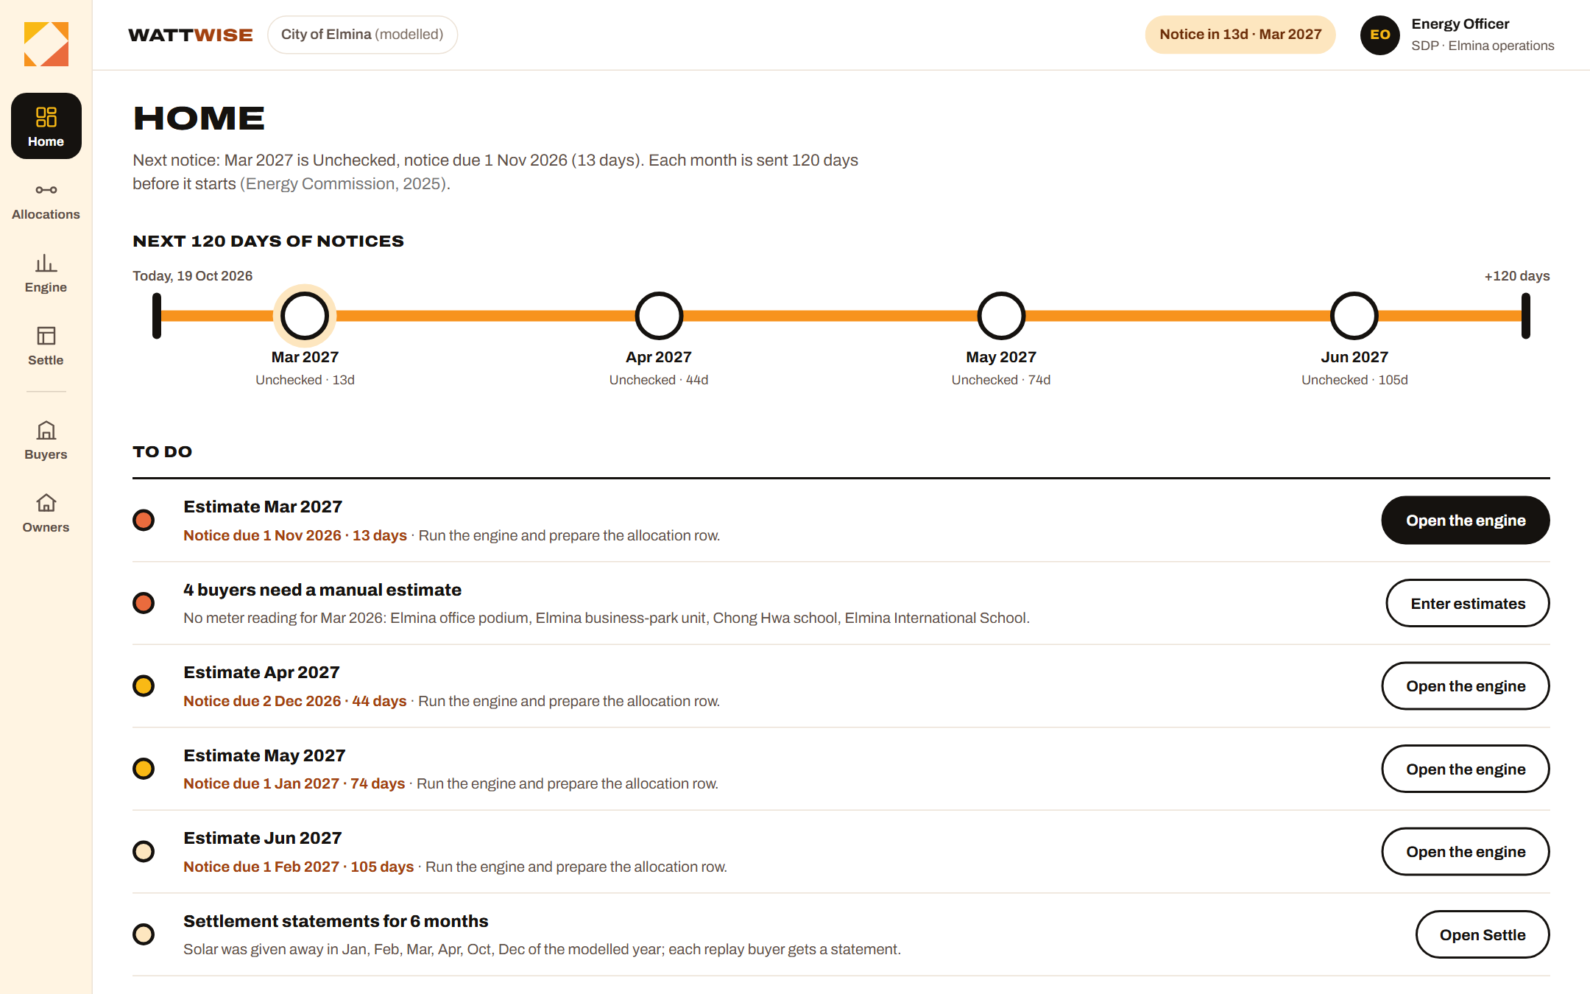
7) FEASIBILITY
A working prototype, tested on real meters
821
real buildings tested
99.8%
of buyer pairs give away less than a fixed split
Resources: public data and a static web app; no hardware, no grid integration
Stakeholders: SDP scheme admin, Energy Commission, TNB (Single Buyer), CREAM buyers
Deployment: 3-month shadow pilot; SDP still files with the Energy Commission
Try the testing suite: re-run every number
Operator app prototype (screenshot). Fits SDP's digital energy services strategy (Sime Darby Property, 2026a).
Check these numbers: Appendix A (821 buildings) and Appendix D (99.8% of buyer pairs).

Slide 10
7) IMPLEMENTATION
How WattWise enters SDP's pipeline
01
02
03
04
05
Shadow pilot
Verify
Live at Elmina
Scale
Expand
3 months, free. SDP shares 3 files: meters, past splits, solar.
Compare suggested, filed and billed splits; report solar given away.
WattWise suggests, the scheme admin approves, SDP files 120 days ahead.
Run monthly for each new buyer; same rules, no new hardware.
Same rules in any CREAM township; more solar means more income.
Build to pilot: ~4–6 weeks
Estimate. Prototype works; left: SDP file import, notice export, security review
Upkeep: near zero
No hardware, no model to retrain; only update rates if the Energy Commission changes them
The first shadow report is back within a day (planned).

Slide 11
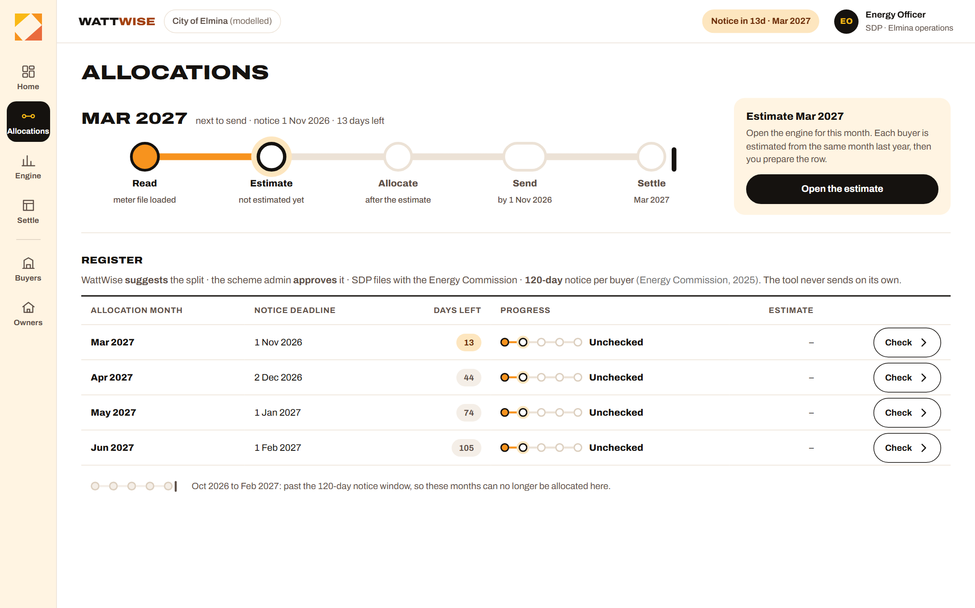
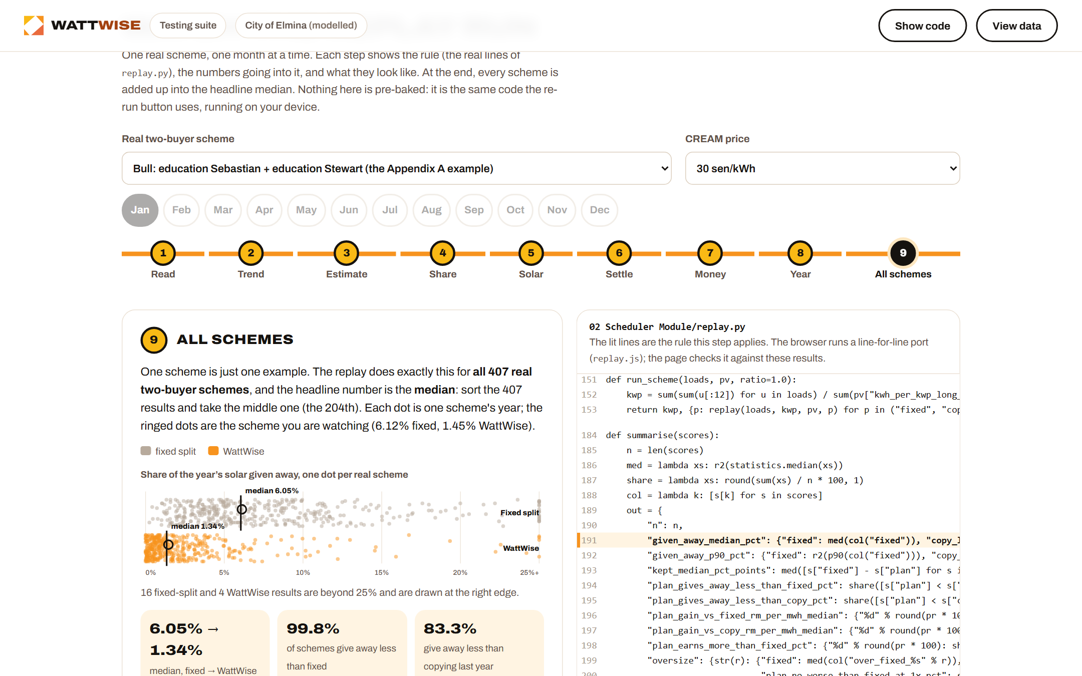
7) VISUAL CONCEPT
Explore the working prototype
Operator app: deadlines, estimate, notice
Testing suite: every claim, re-runnable
OPEN THE LIVE DASHBOARD
OPEN THE TESTING SUITE
Code and data: github.com/ttc-099/Wattwise

Slide 12


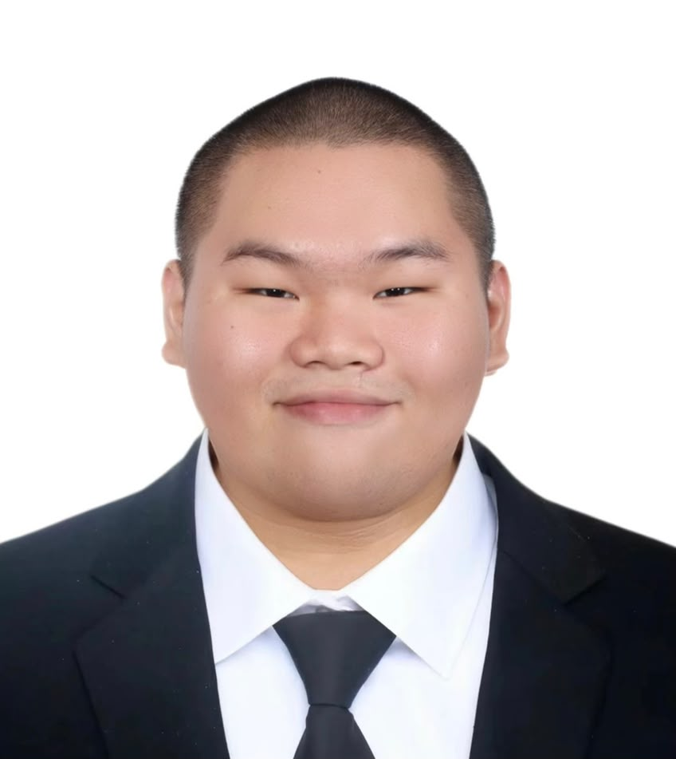
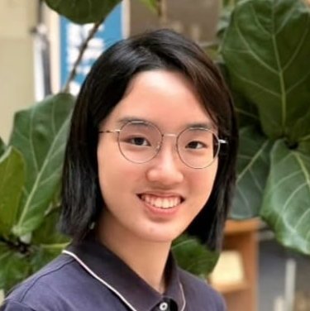
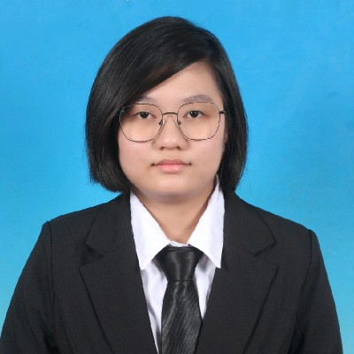
8) WHY WE SHOULD WIN
Malaysia’s grid is under growing pressure from data-centre demand and rising rooftop solar (Selan, 2026). CREAM lets residents’ solar serve nearby businesses, but fixed shares filed 120 days ahead send about 6% of it back to the grid unused. WattWise sizes each share from the buyer’s own meter history and cuts that to about 1.3%, so more local solar is used locally. It deserves recognition because it’s practical and checkable: a working prototype, tested on real meters from 821 buildings, with every number re-runnable by judges.
Sheri Anne
Chong Ting Ting
Ong
Hui Min
Jess
Lau Xi En
Lim
Poh Shiu
Lead, full-stack
UI/UX developer, research
UI/UX designer, developer
Data analyst, QA
Notes:
Slide 12 of the corrected WattWise pitch deck.

Slide 13

FROM TEAM PROMAX,
THANK YOU
FOR YOUR TIME!
Completed: 23 Oct 2026
Notes:
Slide 13 of the corrected WattWise pitch deck.

Slide 14
APPENDIX A: DOES IT REALLY REDUCE SOLAR GIVEAWAY?
Median share of the year's solar given away
Fixed split 6.05% → WattWise 1.34% for buyer pairs.
Test it yourself
Real meters, 821 buildings (Miller et al., 2020); rooftop solar at Elmina (European Commission JRC, 2022); WattWise (2026).

Slide 15
APPENDIX B: HOW MUCH INCOME DOES IT ADD FOR SDP?
Extra gross scheme income a year, by assumed CREAM price
Modest and price-dependent; roof-lease terms are SDP's private deal.
Test it yourself
Modelled, 2 buyers assumed. Before roof-lease payments, costs and tax. At 15 sen the gain would be larger, but 15 sen is below the 17 sen NEDA break-even.

Slide 16
APPENDIX B (CONTINUED): HOW MUCH AT SDP’S 6,000-HOME TARGET?
What WattWise adds to a 6,000-home scheme (modelled)
RM108k–265k
a year more than a fixed yearly split
1.4%–6.6%
of the scheme's total yearly income (RM4.0M–7.9M)
6,000 homes (≈41,000 MWh a year), 2 buyers assumed. Before roof-lease payments, costs and tax.
Extra gross income a year vs a fixed split, by assumed CREAM price
Scales with solar generated: about RM2.6k–6.4k per 1,000 MWh a year (30 to 20 sen). More roofs mean more income; more buyers do not.
Modelled; the CREAM price is private (assumed 20–30 sen/kWh). Scheme income is after the 9 sen grid access charge. Below 17 sen, selling to NEDA beats selling to a buyer.
Check these numbers: Appendix B (extra income by CREAM price and scheme size).

Slide 17
APPENDIX C: WILL THERE REALLY BE SPACE FOR 20% MORE CREAM CONTRIBUTORS?
Solar given away when the solar pool is built larger
Still below today's fixed split, but ~76% of the extra solar sells via NEDA at 8 sen.
Test it yourself
Feeder limits (2 MWp each), roof availability and lease take-up are not modelled (WattWise, 2026).

Slide 18
APPENDIX D: DYNAMIC SPLITTING WORKS BETTER THAN FIXED ONES?
Share of cases where WattWise gives away less
Beats fixed in almost every case; above ~20 sen, copying last year earns slightly more.
Test it yourself
Real meters, 821 buildings (Miller et al., 2020); WattWise (2026).

Slide 19
APPENDIX E: REFERENCES
Energy Commission (2025) Guidelines for Community Renewable Energy Aggregation Mechanism (CREAM), GP/ST/No.55/2025. Putrajaya: Suruhanjaya Tenaga.
Energy Commission (2026) Grid Emission Factor (GEF) in Malaysia, 2022–2024 (Provisional). Putrajaya: Suruhanjaya Tenaga, 23 February. https://myenergystats.st.gov.my/documents/d/guest/grid-emission-factor-gef-in-malaysia-2022-2024-provisional-
European Commission Joint Research Centre (2022) Photovoltaic Geographical Information System (PVGIS) 5.2. https://re.jrc.ec.europa.eu/pvg_tools/
Miller, C. et al. (2020) 'The Building Data Genome Project 2', Scientific Data, 7, 368. https://doi.org/10.1038/s41597-020-00712-x
Selan, S. (2026) ‘Malaysia’s power grid strains under data centre boom and renewables growth’, Eco-Business, 15 September. https://www.eco-business.com/news/malaysias-power-grid-strains-under-data-centre-boom-and-renewables-growth/
Sime Darby Property (2026a) Integrated Annual Report 2025. Sime Darby Property (2026b) Sustainability Report 2025.
Skrine (2025) Energy Commission issues guidelines for Malaysia's CREAM [Legal alert]. April.
The Malaysian Reserve (2025) 'Sime Darby Property, TNB launch pilot solar project under CREAM to power homes, industries', 26 September.
WattWise (2026) WattWise code and results. https://github.com/ttc-099/Wattwise. Every figure is rebuilt by python replay.py in 02 Scheduler Module.
References in the testing suite

